Slide 1


e-AFFECT
e-assessment and feedback for effective course transformations
Dr Anne Jones
Centre for Educational Development

Slide 2
About e-AFFECT
This is one of eight projects funded by JISC (£197,755) for two years but will run longer
This is an institutional project to transform assessment and feedback practice and policy using technology where appropriate

Slide 3
Project timeline

Slide 4
Participants
Phase 1
Civil Engineering
English
Psychology
Phase 2
Business Management
Computer Science
Creative Arts
Drama
Film Studies
Music
Music Technology
Environmental Planning
Pharmacy

Slide 5
Steps in each phase: Year 1
Baseline activities – collection of:
Student experiences and perception of assessment and feedback – including how you use the feedback you get
Staff experiences and perceptions of assessment and feedback
Module and pathway statistics
School policies for assessment and feedback
Mapping of the types of assessment used and when they take place
Information about what feedback is given, how and when
Business processes for the management of assessment and feedback in the School

Slide 6
Assessment timelines
Adapted from the ESCAPE project, University of Hertfordshire
Notes:
Replace this one with up dated one

Slide 7


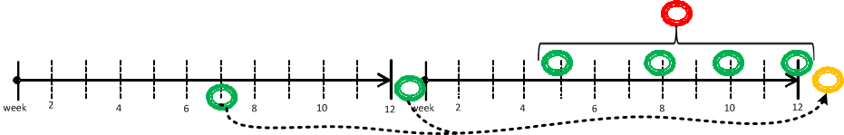
Assessment and Feedback exemplar timelines
Adapted from the ESCAPE project, University of Hertfordshire
Notes:
Other egs
A very powerful visual tool that can clearly demonstrate issues such as ‘bunching’ of assessment – for students and staff - and potentially over assessment
As well it can demonstrate where students get opportunity for formative activity – as in this slide – or a concentration on summative assessment as in the next slide.

Slide 8
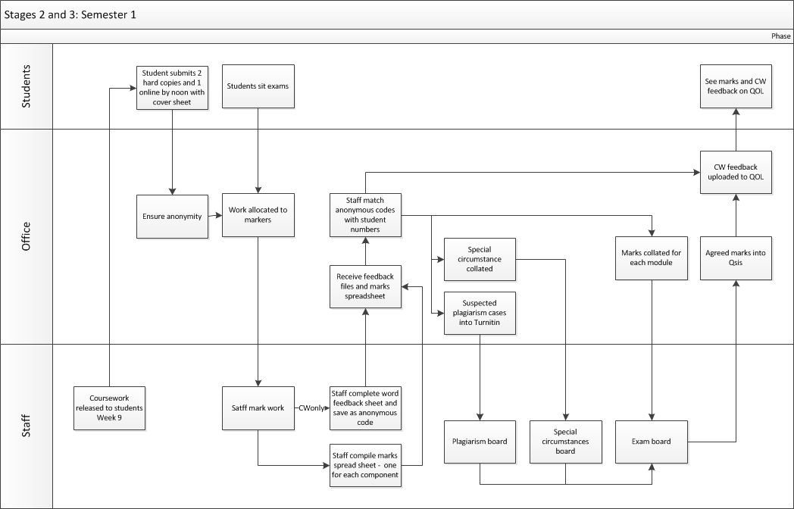
Business Processes

Slide 9
Year 1 continued
Planning for the future (Jan - March)
This takes place after the baseline information
has been analysed
Staff look at what works well and how
this can be developed
Appreciative Inquiry
Action Planning
Development of the activities identified
from the planning stage (April – June)
This may involve some students in helping to put together materials, such as training materials, for staff and students to use
Assessment and Feedback
Discover
Dream
Design
Deliver
Notes:
Starts with an affirmative (positive) topic – in our case the positives of assessment and feedback experiences
Change methodology
Inquiry into what works well before introducing change
Strengths-based approach
Dialogue and making meaning
Structure – 4-D cycle – discovery, dream, design and deliver (destiny)
Discover – high-point experiences and identifies strengths and capabilities → positive core
Dream – imaginatively and collectively envision what is possible
Design – co-construct what can be done to ‘build capacity’
Deliver (destiny) – commit to the iterative exploration of learning, innovation and delivering results that all stakeholders care about

Slide 10
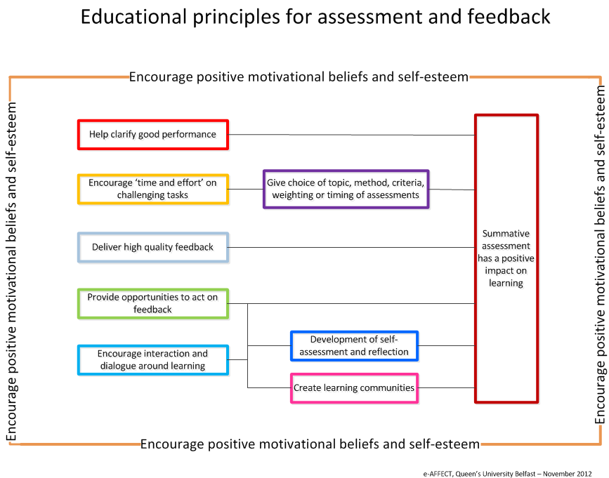
Notes:
Developed from the REAP project - Strathclyde

Slide 11
Year 2 and onwards
Piloting the developments from Year 1
Student and staff evaluations of the activities
Refinement
Embedding and continuous review
Developments will become embedded in the Postgraduate programmes as well

Slide 12
Where are we now?
Phase 1
Civil Engineering – three projects running in three modules; engaging students with assessment criteria via Peermark and with exemplars; using QuestionMark Perception to deliver examination practice
English – embedding e-marking/feedback using QOL; QuestionMark Perception being used in a phonetics module
Psychology – analysis of feedback provided to students
Phase 2
Baselines complete
Appreciative Inquiry workshops scheduled

Slide 13
Year 3
Embedding and continuous review of Phase 1
Piloting developments from Phase 2
Starting Phase 3 activities – still seeking volunteers

Slide 14
Marketplace

Slide 15
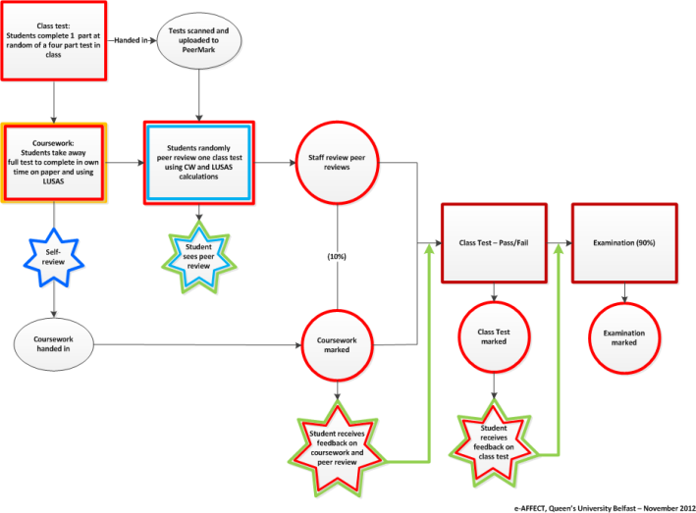
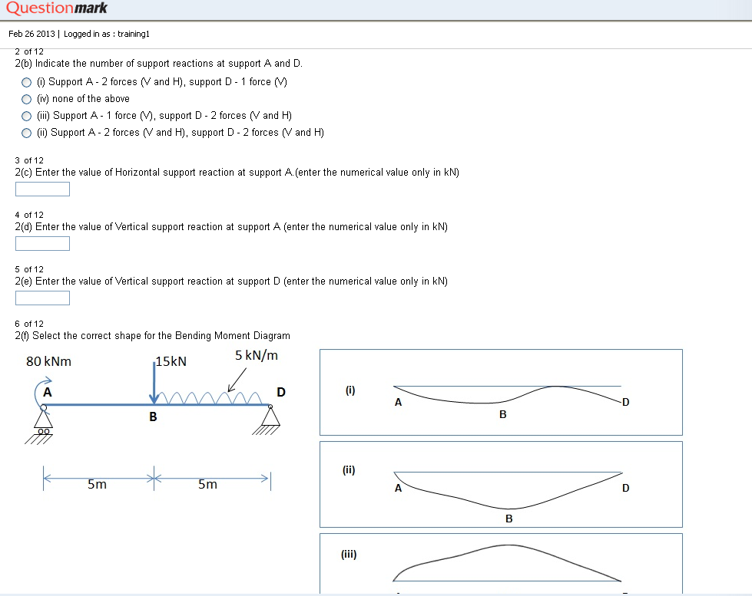
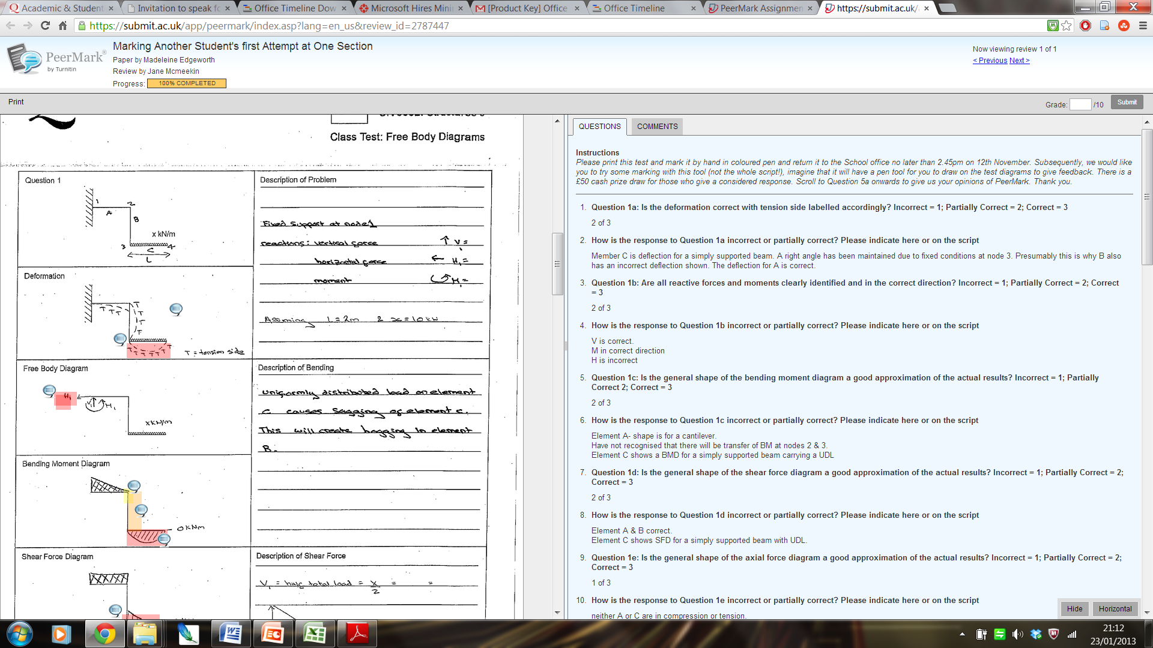
Civil Engineering
EXEMPLARS FOR REPORTS

Slide 16
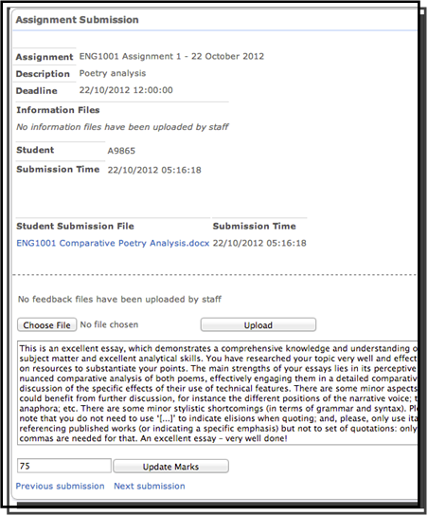
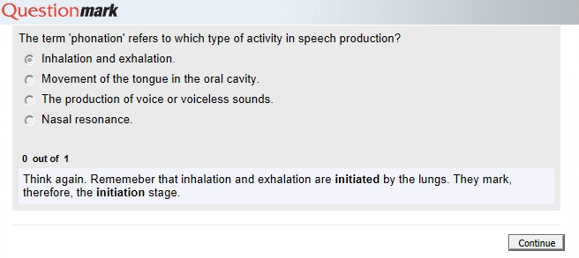

School of English

Slide 17
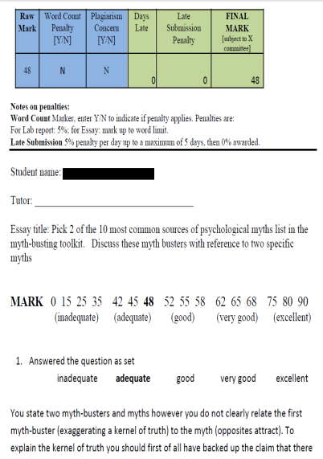
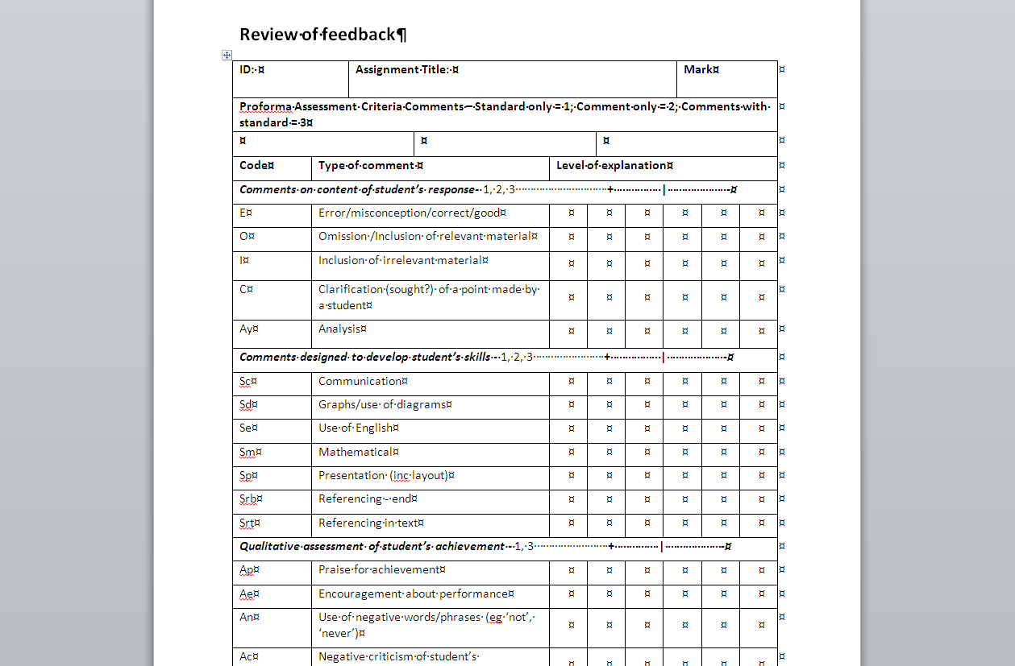
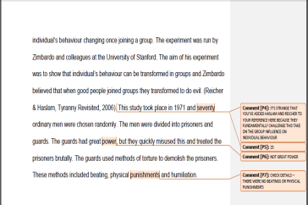
School of Psychology
Weaknesses
Strengths

Slide 18
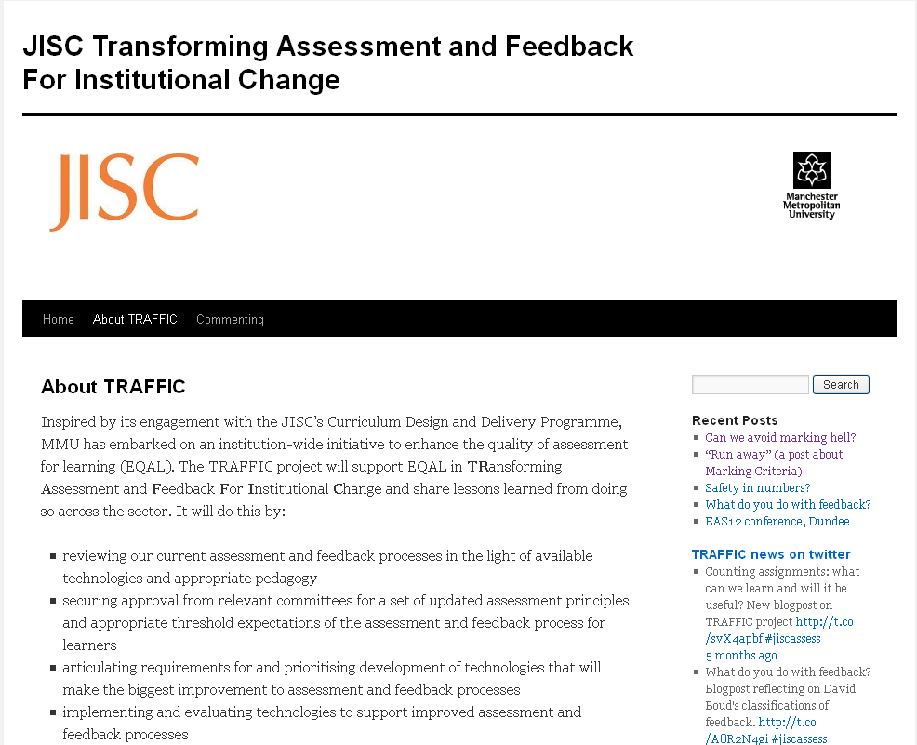
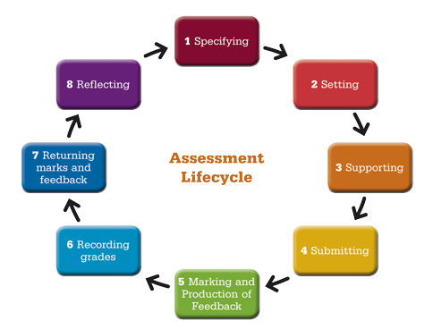
TRAFFIC – Manchester Metropolitan University
Notes:
Our project is looking at institutional systems and the outcomes of our analyses, so the ‘wares’ will be related to the impact that these outcomes have had on institutional policy and practice.

Slide 19
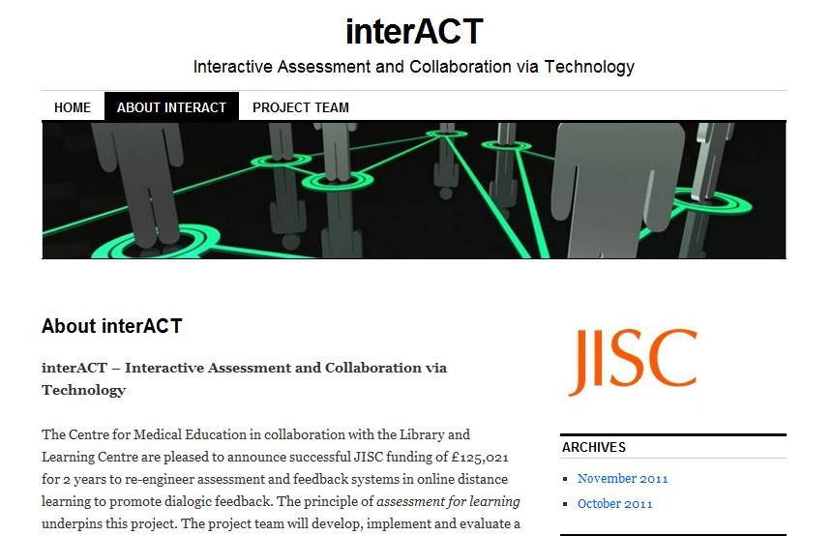
Project website http://blog.dundee.ac.uk/interact

Slide 20
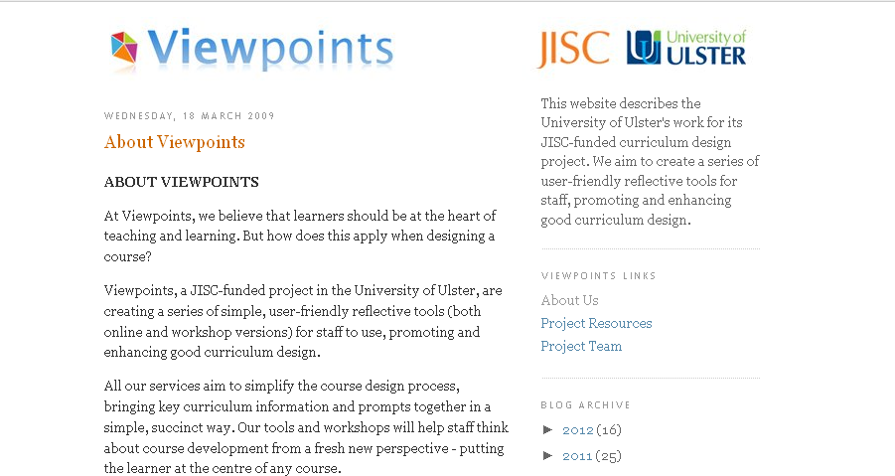
Viewpoints – University of Ulster

Slide 21


Searching for deep learning online: A case study of scaffolding reflective writing in online classrooms
Dr. Eloise Tan
Learning Innovation Unit, Dublin City University
Facilitating and scaffolding reflective writing in an online environment can present unique challenges for both lecturers and students. These challenges largely stem from the personal and introspective nature of reflective writing and the perceived impersonal nature of technology by some (Weiss, 2000). This poster presents possible models for assessing and scaffolding reflective writing in an online course. It also outlines lessons learned from assessing reflective writing in two online courses.

Slide 22
Marketplace takes place in the Great Hall
Return to Council Chamber for 2pm
Dr Gwyneth Hughes
“Progress across the programme: a longitudinal view of assessment for learning”

